Slide 1

Building Your Backlog
Martin Schray

Slide 2

“You can’t climb a mountain in one step or build a product in one minute. The backlog is about capturing what needs to be done to be worked just at the right time.”
- Martin Schray

Slide 3
“You can’t do 20 things at once and hope to make much progress on any of them.”
- Martin Schray

Slide 4
What is a (product) backlog?
Think of a (product) backlog as a list of everything that needs to be done to build your product (or at least a release of your product)
Think of the top of your backlog as the most important things to get done in priority order
What is in your backlog? Product Backlog Items (PBI) [frequently just called stories]
Where does the product backlog exist? A column (likely the first column) in your board tool (in our case Github Projects)
How big or small is each PBI? Small enough to fit into a sprint
Build Facebook (ridiculously too huge)
Call stakeholder X (this is more of an activity probably too small)
Develop two draft problem statements (just right – bigger than a task or activity)
Who should own a story (when it’s pulled)? Ideally ONE person

Slide 5
What is the sprint Backlog?
The Product Backlog Items (PBI – AKA stories) that are being worked on this sprint are called the sprint backlog
Where does the Sprint backlog exist? A column (likely the second column) in your board tool (in our case Github Projects)
These stories should be ready for the 3Cs
Card
Conversation (with needed stakeholders, representitive users or customers)
Confirmation (what has to be for this story to be done)

Slide 6
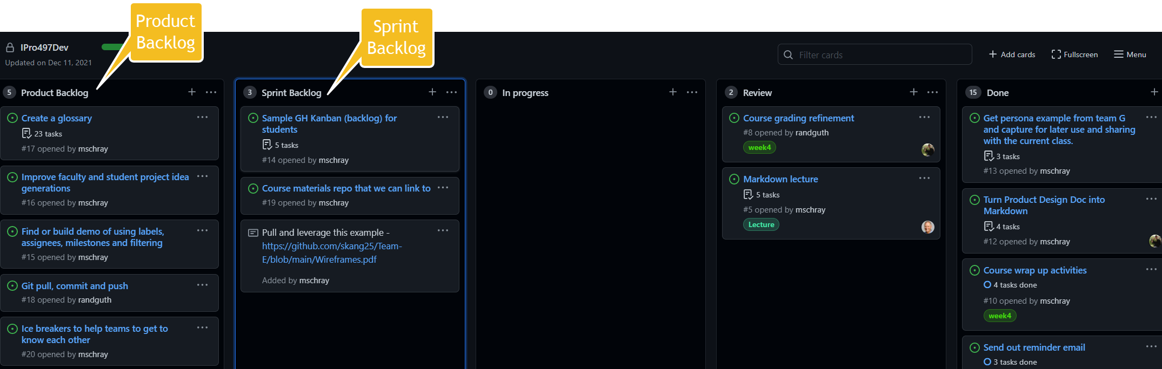
Product Backlog and Sprint Backlog Visually

Slide 7
Product Backlog and Sprint Backlog Visually
Product Backlog may contain 50, 100, 300 items
Sprint Backlog is only the things can be completed this sprint (so a small number of items)

